Slide 1


Introduction to Korean Language

Slide 2

Basic Knowledge of Korean Language
1
Korean Alphabet
2
Greetings and Expressions
Learn about the shape and pronunciation of the Korean alphabet and understand basic words and sentences.
Learn the most basic greetings and expressions necessary for conversation in Korea.
3
Numbers and Time
Learn how to express numbers and time in Korean and understand various customs applied in Korean society.

Slide 3
안녕하세요? 제 이름은 맥스입니다.
Hello? My name is Max.
A sentence consists of one or more words.
제, 이름은, 맥스입니다 A word is made up of several letters.
이, 름, 은, 맥, 스, 입, 니, 다 Letters consist of a combination of consonants and vowels.
ㅇ, ㅣ, ㄹ, ㅡ, ㅁ

Slide 4
We will learn consonants and vowels.
So we can read and make one single letter.
Then we will learn several kinds of words.
Finally, we will learn a few sentences.

Slide 5
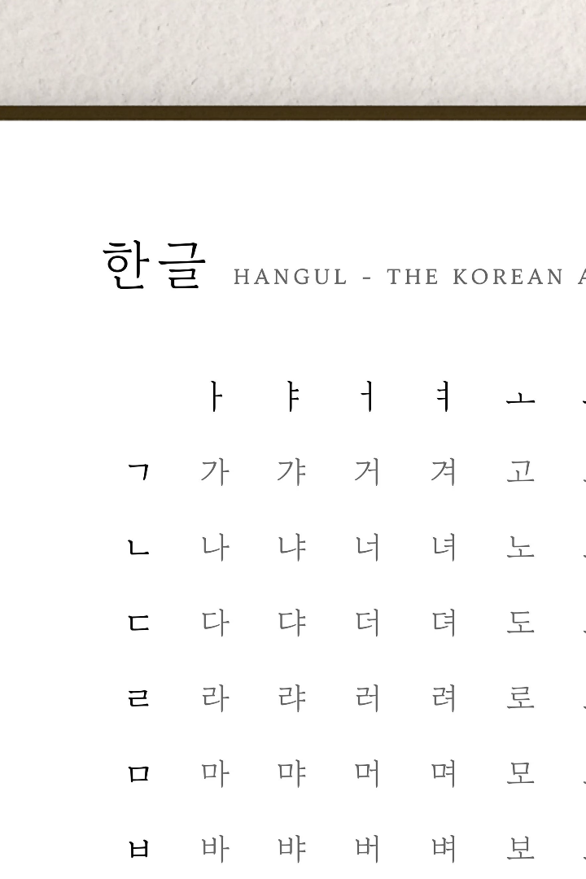
Learn the Korean Alphabet
The Korean alphabet, or Hangul, was created in the 15th century and is known for its scientific and efficient design. In this card, we will cover the basics of the Korean alphabet and provide resources for learning it.
Learn the 14 consonants and 10 vowels
Understand the pronunciation rules
Practice reading and writing Korean words

Slide 6

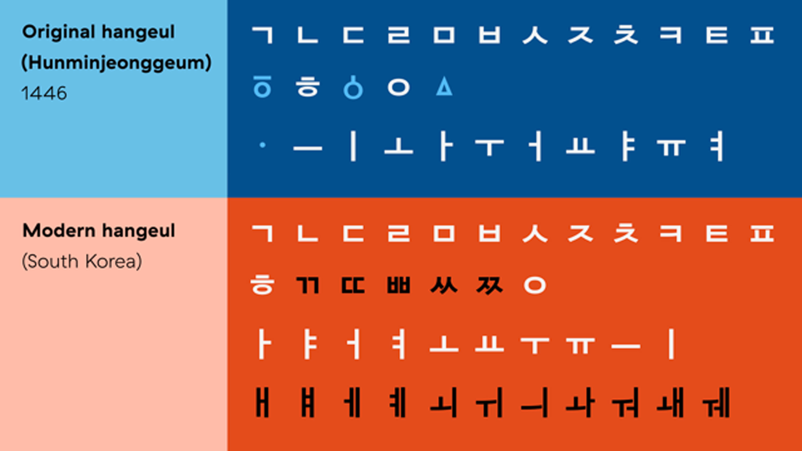

Slide 7
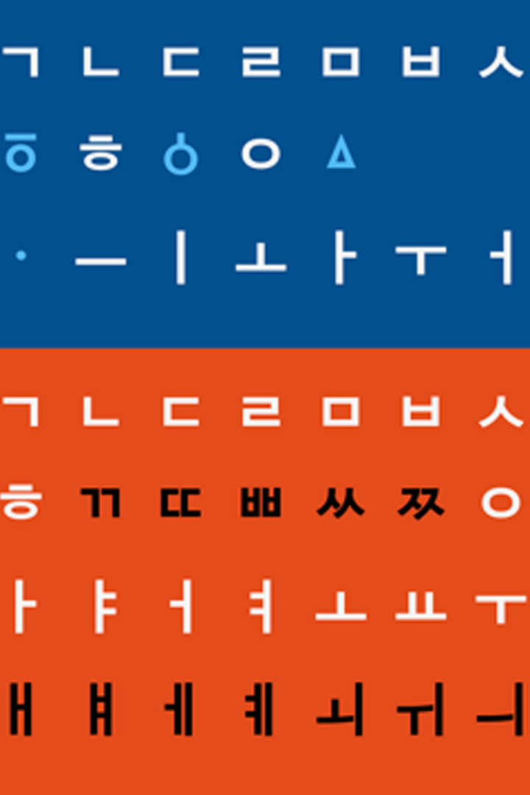
Korean Alphabet Lecture
Consonants
The Korean alphabet has 14 consonants. Each consonant is pronounced with one of three mouth shapes: ㄱ, ㄷ, ㅂ, and ㅈ are pronounced with a tensed mouth shape, while ㄴ, ㅁ, ㅇ, and ㄹ are pronounced with a lax mouth shape. The remaining consonants, ㄲ, ㄸ, ㅃ, ㅉ, and ㅊ, are pronounced with a double tensed mouth shape.
Vowels
The Korean alphabet has 10 vowels. Each vowel is pronounced with one of two mouth shapes: horizontal or vertical. The horizontal vowels are ㅏ, ㅓ, ㅗ, and ㅜ, while the vertical vowels are ㅣ, ㅡ, and ㅔ. The remaining three vowels, ㅐ, ㅒ, and ㅖ, are pronounced with a combination of the horizontal and vertical mouth shapes.

Slide 8
Pronunciation Rules
The pronunciation of Korean words is determined by several rules. Some of the most important rules are:
The first consonant in a syllable is pronounced with the tensed or lax mouth shape depending on the position of the consonant in the word.
A tensed consonant followed by a horizontal vowel is pronounced with a breathy voice.
A tensed consonant followed by a vertical vowel is pronounced without a breathy voice.
The vowel ㅣ is pronounced as "ee" when it is at the beginning of a syllable or when it follows a tensed consonant.
The vowel ㅡ is pronounced as "eu" when it is at the beginning of a syllable or when it follows a tensed consonant.

Slide 9
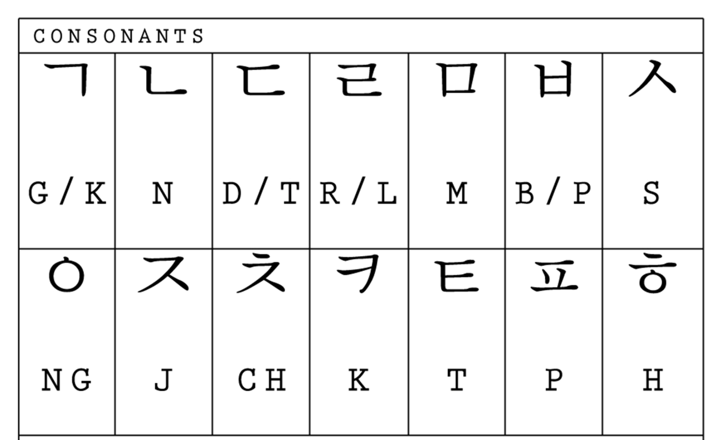

Slide 10
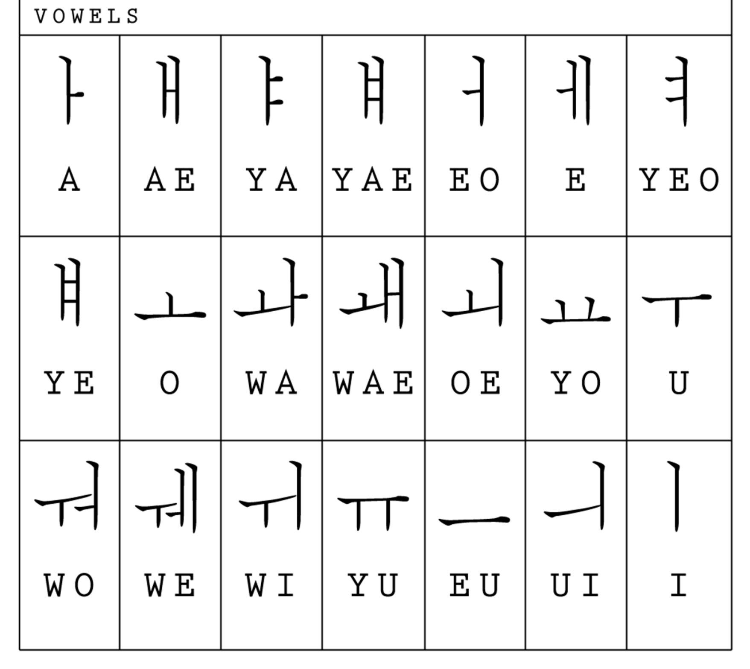

Slide 11
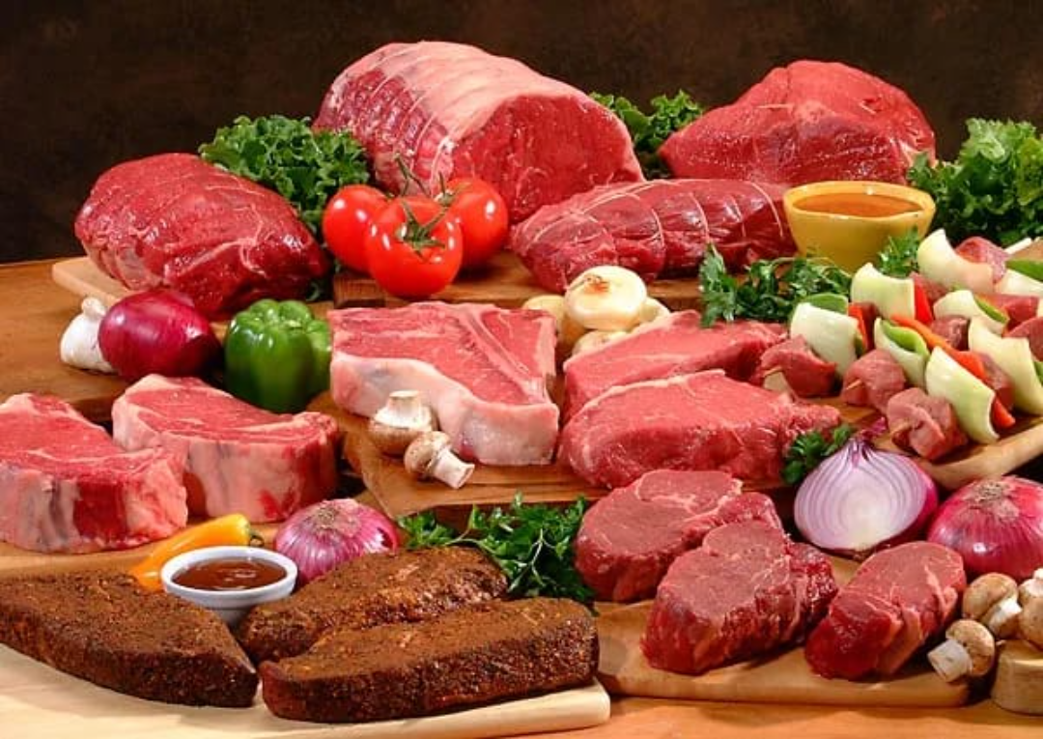
1. 고기 ( gogi) : meat

Slide 12

2. 다리 (dari) : bridge

Slide 13

3. 사랑 (sarang) : love

Slide 14

Useful Korean Phrases for Beginners
1
Hello: 안녕하세요.
An nyeong ha se yo.
2
Thank you: 감사합니다.
Gam sa hab ni da.
3
My name is ~: 제 이름은 ~입니다.
Je i reum eun ~ imnida.

Slide 15
Q&A and Wrap-up
Frequently Asked Questions
Recommended Learning Resources
Answers to Questions Not Covered in Class
We provide answers to frequently asked questions from students.
We recommend useful Korean-related videos, websites, apps, etc. and guide you on how to continue learning.
Feel free to ask any questions you may have not covered in previous classes, and we'll provide detailed answers.

